Slide 1
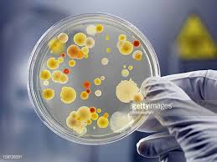
Define the following terms and give an example of each:
Communicable –
Bacteria –
Virus –
Fungi –
What are the different ways pathogens are spread?
By air –
Direct contact –
By water –
(BIOLOGY ONLY) Describe how you would grow useful bacteria in a science lab and how you ensure it is done safely:
(BIOLOGY ONLY) Calculating bacterial growth:
Equation for number of times bacteria divide in a set amount of time.
Equation for calculating the number of bacteria in a population.
Compare the effectiveness of antibiotics and disinfectants using ∏r² on the image below.
Topic 3 Infection & Response
Different diseases
Name | Bacteria / Virus / Fungi / Protist | Symptoms | Problems | Treatments
HIV / AIDS
Salmonella
Malaria
Rose black spot
Gonorrhoea
Measles
Tobacco Mosaic Virus
(BIOLOGY ONLY) Describe different plant defences:
Explain what a vaccine is and how it works.
Describe how herd immunity works.
Describe the stages of drug testing and why each stage is important:
Describe the role and function of the three types of white blood cell:
Phagocytosis:
Antibodies
Antitoxins
(BIOLOGY ONLY) How are monoclonal antibodies used to treat disease?
(BIOLOGY ONLY) How are monoclonal antibodies made?
What are they used for?
Pregnancy tests –
Diagnosis of disease –
Monitoring –
Research –
Treatment -
Compare the uses of antibiotics and painkillers.
Describe how penicillin was discovered.
Advantages | Disadvantages

Slide 2
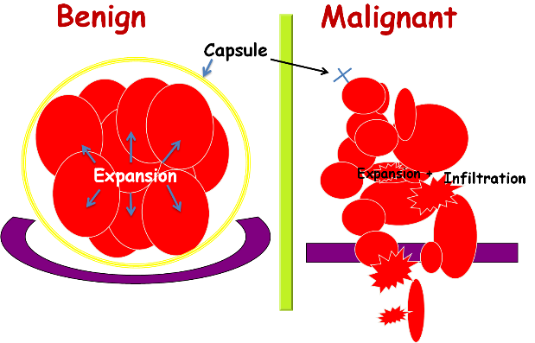
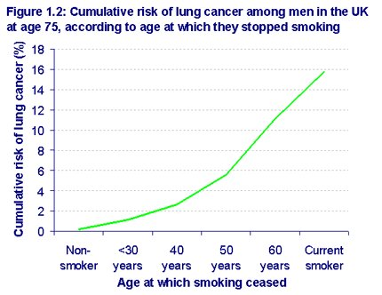
List different risk factors that affect disease:
Compare the formation of malignant and benign tumours.
Benign –
Malignant –
Risk 1: Smoking
Nicotine –
Carbon monoxide –
Smoking during pregnancy –
Carcinogens –
Smoking and the heart -
Risk 2: Diet, exercise and disease
Diet, exercise and obesity –
Exercise and health –
Obesity and type 2 diabetes -
Describe these, in terms of the graph below:
Casual mechanism
Correlation
Describe the treatments of cancer:
Radiotherapy:
Chemotherapy:
1. Label the different places pathogens can enter the body.
2. Describe the protective defences at each place.
Risk 3: Alcohol and Carcinogens
Alcohol and health –
Brain and liver damage –
Alcohol and pregnancy –
Ionising radiation -
What is a coronary artery and where would you find them?

