Slide 1
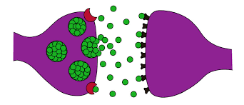
Complete the flow chart for a nervous system response of a dog seeing and chasing a cat.
Senses and Sense organs
Stimulus | Sense Organ
Light
 | Tongue
Smell
Touch
 | Ear
(BIOLOGY ONLY) Common problems of the eye and new technology:
Accommodation –
Myopia –
Hyperopia –
Contact lenses –
Laser eye surgery –
Replacement lenses -
Complete the flow chart for a reflex response of someone standing on a hot pin. Remember - SRSRMER
Order of a nervous response
Step | Description
Stimulus
Receptor Cells
Sensory Neurone
Coordination centre
Motor Neurone
Effector
Response
Order of a Reflex
Step | Description
Topic 5 Homeostasis and Response
(BIOLOGY AND HIGHER ONLY) The Brain:
State the role of:
Cerebral cortex -
Cerebellum -
Medulla -
Describe the ways of studying the brain:
Brain damage -
Electrical stimulation -
MRI scans -
Problems studying the brain -
Glands and Hormones
Gland | Hormone | Function
Pituitary
Thyroid
Pancreas
Adrenal
Ovaries
Testes
(BIOLOGY AND HIGHER ONLY) The Eye:
State the role of:
Pupil -
Iris -
Retina -
Optic nerve -
Suspensory ligaments -
Ciliary muscles -
Describe how the eye focusses light:
Describe how a synapse works:

Slide 2
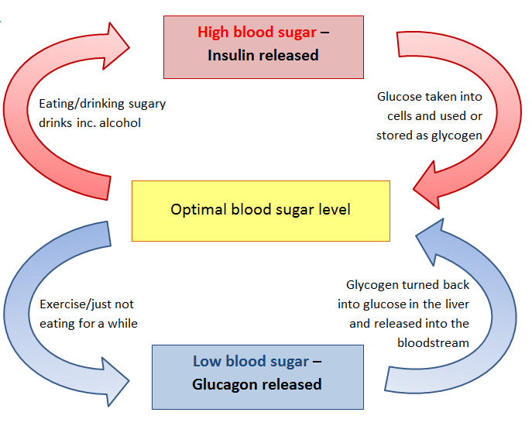
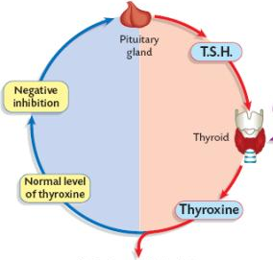
Endocrine system:
What is a hormone?
What is an endocrine gland?
Why is the pituitary gland called a master gland?
Describe how the following control blood glucose:
Insulin
Glucagon (HIGHER)
(HIGHER) Negative feedback:
Describe what negative feedback is in terms of thyroxine.
Why can adrenalin not be used in a negative feedback system?
Describe the role of each of the hormones in the menstrual cycle:
FSH
LH
Oestrogen
Progesterone
Fertility Treatments
Method | Description
Hormone-based contraception
Chemical methods
Barrier methods
Intrauterine devices
Abstinence
Surgical methods
Comparing Types of Diabetes
Question | Type 1 | Type 2
Cause?
Symptoms?
Treatment?
Cure?
Describe the steps involved in IVF:
Hormones given to the mother –
Collect eggs –
Eggs are fertilised in a laboratory –
Fertilised eggs are preserved –
Ball of cells created –
What is the treatment for women who do not make enough FSH?
Describe the effects of auxin on roots and shoots.
Plant hormones – Define these:
Phototropism:
Gravitropism:
(BIOLOGY ONLY) How can plant hormones be used?
Auxins –
Gibberellins –
Ethene –
(BIOLOGY ONLY) What is an advantage and disadvantage to using plant hormones?
A -
D -
Advantages and Disadvantages of Fertility Treatments
Advantages | Disadvantages

Slide 3
How is temperature controlled:
Receptors –
Brain –
Describe the functions of the kidney:
2. Explain how the kidneys work:
3. Explain what selective reabsorption means:
1. Describe how each of the waste products are removed from the body:
Carbon dioxide –
Urea –
2. How is urea produced and why does it need to be removed?
3. Where do all of the waste products come from?
Topic 5 (B12) Homeostasis in Action (BIOLOGY ONLY)
Homeostasis
Factor | Too High | Too Low
Temperature | Vasodilation – Sweating - | Vasoconstriction – Shivering – Sweating reduced -
Water (Concentration of Mineral ions) | Concentrated urine – More ADH – Kidney reabsorbs more water – | Dilute urine – Less ADH – Kidney reabsorbs less water –
Comparing Kidney Treatments
Treatment | Description of treatment | Advantages | Disadvantages
Dialysis
Kidney Transplant

